Slide 1
3rd Party Libraries
IN721 2017
Design and Development for Mobile Devices
Session 12.1
Notes:
Today is independent in-class work day.
You will have a number of exploratory tasks to perform, and I will be marking them off in class.
In a moment, you’ll have the handout.
After about an hour, we will stop and talk about what you need to do for next time.
But first….

Slide 2
Design Readings
Comments on chapter 5?
This week: Chapter 6 of Clifton (examinable)

Slide 3
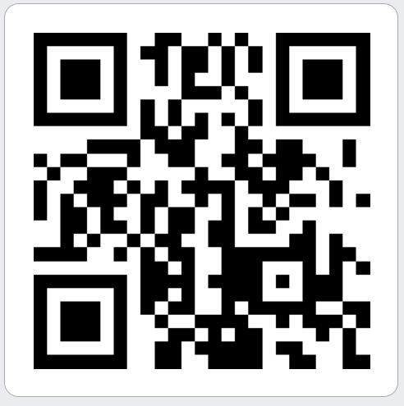
For Friday
Create a QR code (there are several sites that provide this facility) for the month in which you were born.
Save it as a jpg (snipping tool works well).
Title it informatively.
Email it to me by Thursday at 5.00
Notes:
For efficient parsing, your QR codes need a clear white border, like this.

Slide 4
Prepare for QRCode Practical
Review intents.
Review passing data with StartActivityForResult.
Learn about these Android classes:
SparseArray<T>
SurfaceView (this is a screen widget)
CameraSource
BarcodeDetector
Learn about these Interfaces
Detector.Processor<T>
SurfaceHolder.Callback
Notes:
We will be doing this in class, and I want, if possible, to get it done during class time.
So you need to come in already knowing how these classes work
Be prepared to discuss.
Building a prototype would be sensible, but make sure you understand what all the elements are for and how they are interacting. Don’t just robocode.

